Slide 1
Introduction to Docker Compose
Krishnappa, Nandisha

Slide 2

Agenda
What is Docker Compose?
3 Steps of Docker Compose
Docker Compose File Format
Demo

Slide 3

What is Docker Compose?
A tool for defining and running multi- container Docker applications
With Compose, you use a YAML file to configure your application’s services.
Compose works in all environments: production, staging, development, testing, as well as CI workflows.
With a single command, you create and start all the services from your configuration

Slide 4
Docker Compose is a 3 Steps Process
Define your app’s environment with a Dockerfile
Define the services that make up your app in Docker Compose file
$ docker-compose up
Done!!!

Slide 5


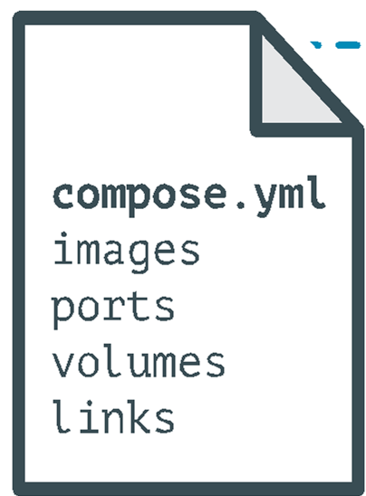
Docker Compose: Multi Container Applications
version: '3'
services:
web:
build: .
ports:
- "5000:5000"
volumes:
- .:/code
depends_on:
- redis
redis:
image: redis

Slide 6
Thank you

